Slide 1
Review of CAR# 163915649

Slide 2
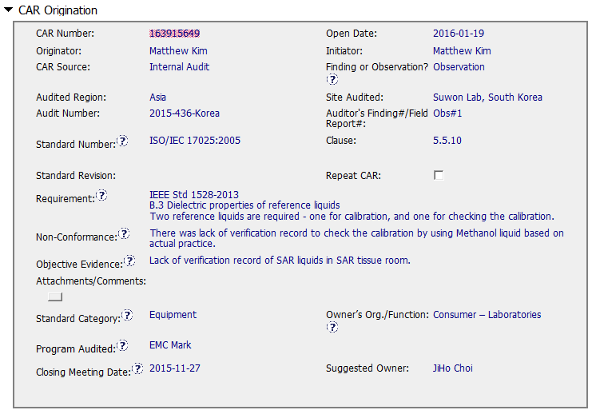
Open date was 2 months after closing meeting
State ISO requirement first
Standard Clause and Category not appropriate for this non conformance.

Slide 3
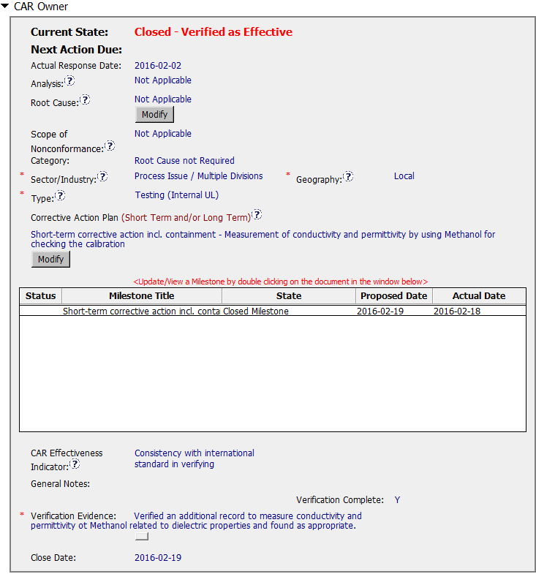
Information not required for Observation

Slide 4
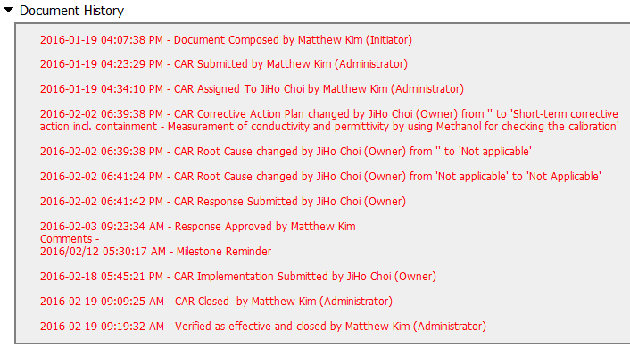
Good Response time.

Slide 5
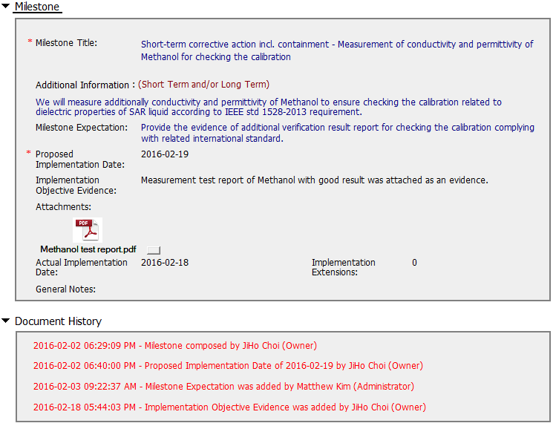
Good information

Slide 6
CAR 163915649 – CBS Check
CBS Requirements | Meets | Needs Improvement | N/A | Comments
Integrity |  | X |  | Good: CAR did not need any extensions and was completed within appropriate timeframe Improve: Date when CAR was inputted into the database from closing meeting ; standard number and category of standard could be improved.
Competitiveness | X |  |  | Observation did not need root cause. Milestone addressed the needed information to satisfy the observation.
Collaboration |  |  | X | There was no need for any communications

